Slide 1
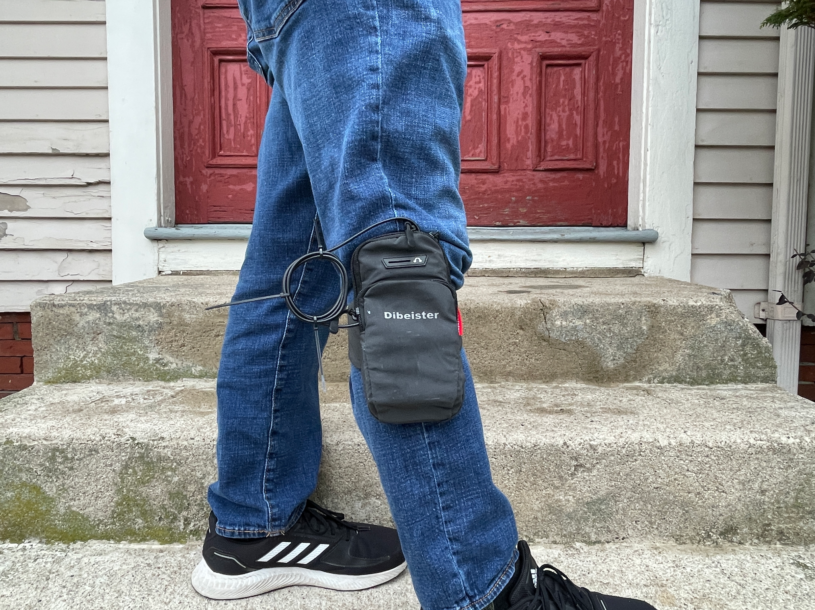
Bluetooth Smart Pedometer
Zachary Murtishi, ELE 547

Slide 2
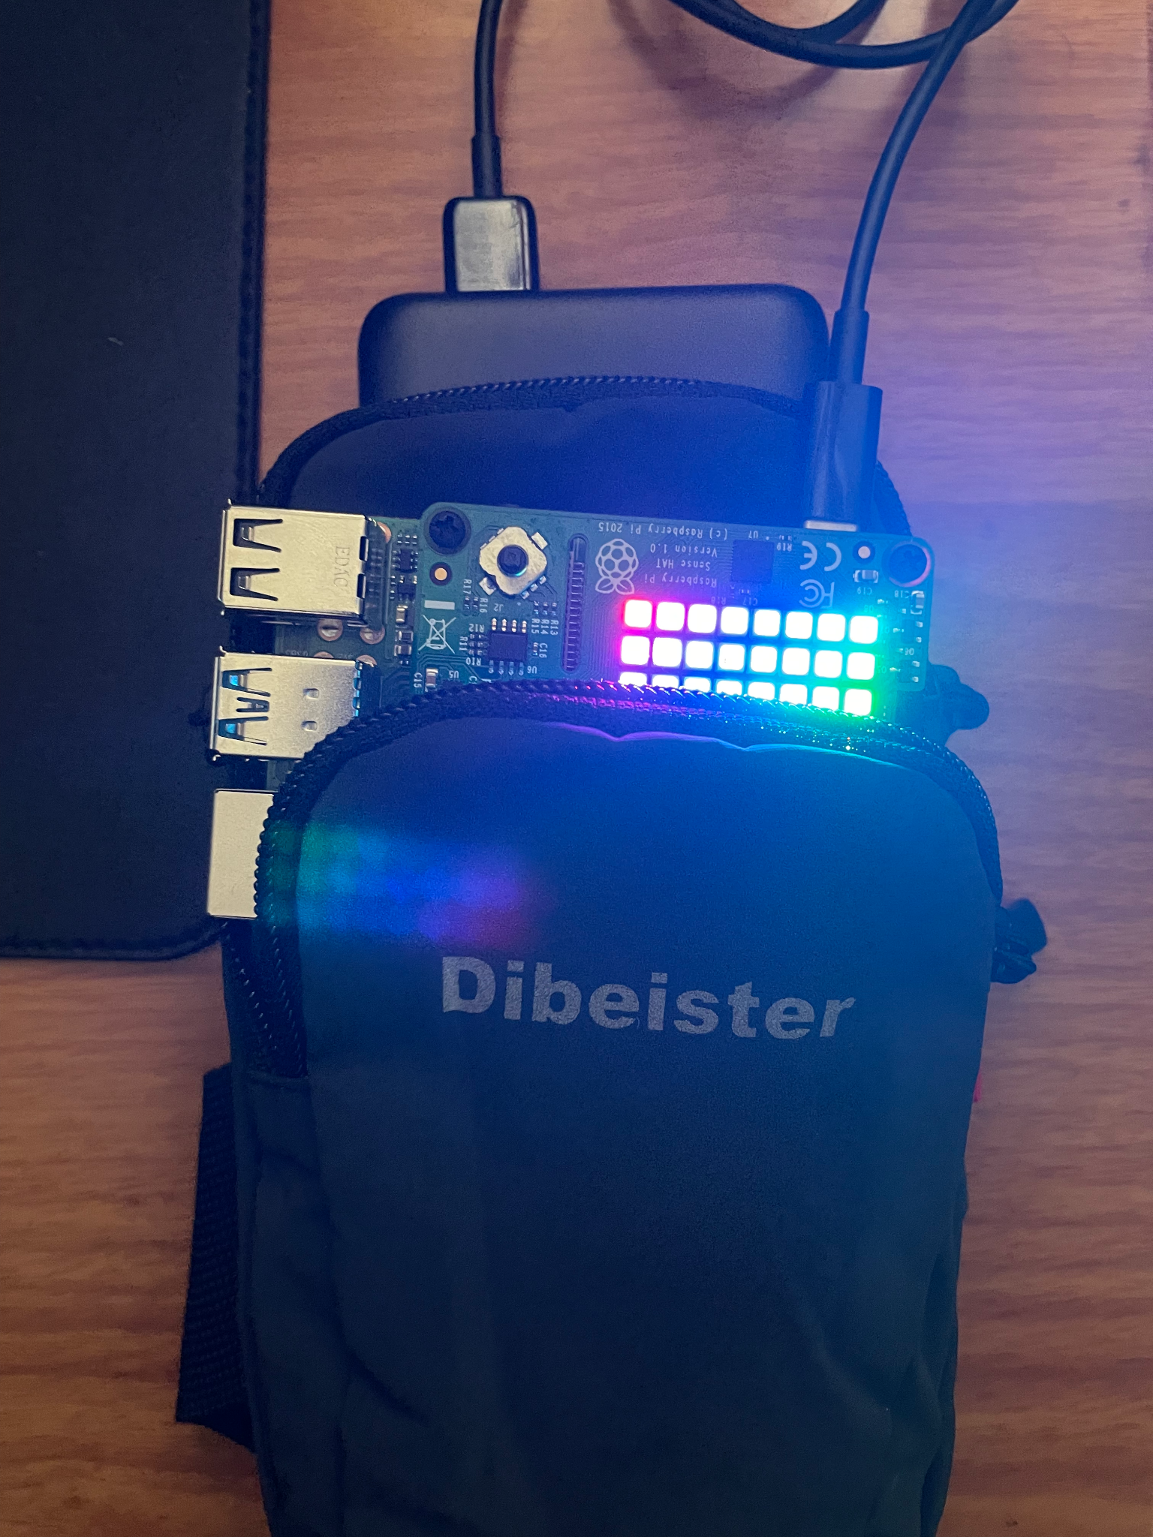
Project Goal
The goal of this project was to develop a functional, wearable implementation of a Bluetooth-enabled smart pedometer that uses a neural network to process sensor data
It is intended to be a real-time device, with motion detection and step counting occurring in real-time.
Complete system with components visible

Slide 3
System Components
The complete system is comprised of the pedometer and the client
Pedometer
Raspberry Pi 4, Sense Hat
Wearable device, used to collect motion data for processing
Can perform on-board motion processing in the absence of client system
Leg-mounted pouch and battery allow for portable use
Client
Laptop computer (ThinkPad X270 running Linux Mint 21)
System used to run neural network to determine if user is walking and count steps, features a graphical user interface for pedometer system’s operating metrics

Slide 4
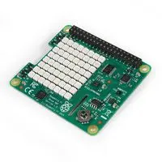
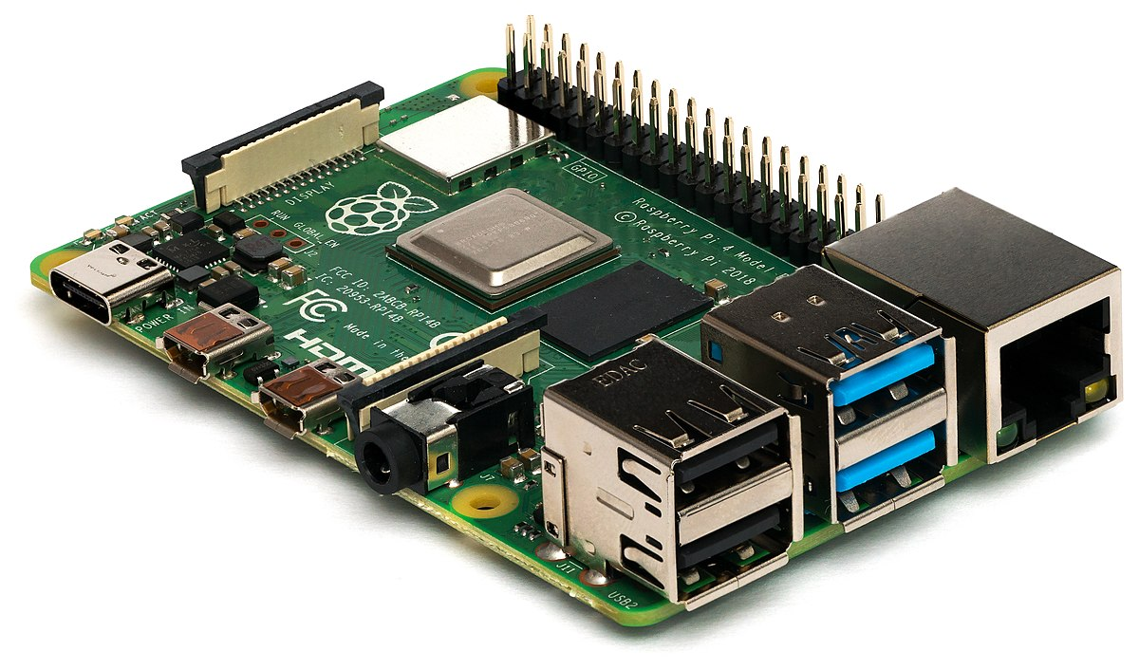
System Block Diagram
Sense Hat
I2C
Bluetooth connection
Raspberry Pi
Client
Pedometer

Slide 5
Software Dependencies
Software developed for Linux distributions
Raspberry Pi OS / Raspbian (Pedometer)
Linux Mint 21 (Client)
Python 3.9
TensorFlow/Keras
Neural networks
Pybluez library
Bluetooth sockets
NumPy
Matrix operations
Sense Hat API (modified)
Provides Python interface to Sense Hat gyroscope
Mod: remove dictionaries, replace w/ lists
Other built-in Python libraries
Unix sockets

Slide 6
Motion Classification and Step Counting
Step counting has several approaches
“Dumb” pedometers may rely solely on running zero-crossing algorithm on motion data
“Smart” pedometers may use advanced algorithms to determine step count, but not in real-time
Both make use of accelerometer or gyroscope data (1)
Hybrid approach
Use trained convolutional neural network in conjunction with a classical zero-crossing detection algorithm to perform step counting
If walking motion is detected by neural network, check for # of zero crossings in gyroscope Z-axis data sent to neural network
Hybrid approach allows for real-time step counting on low-power ARM platform

Slide 7
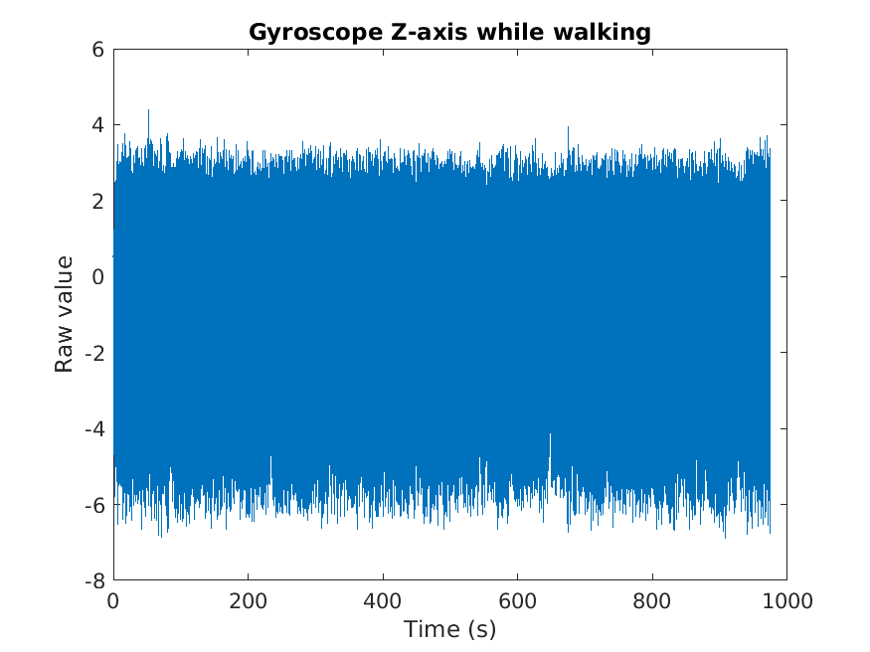
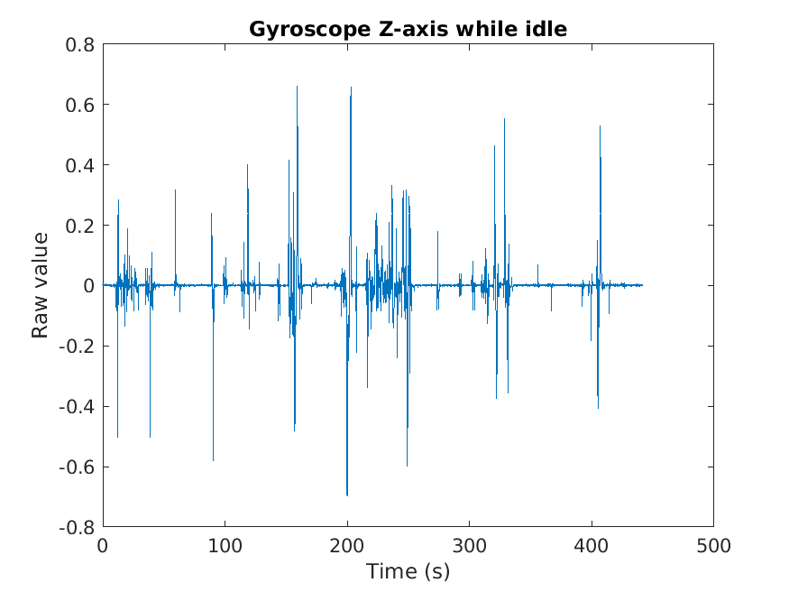
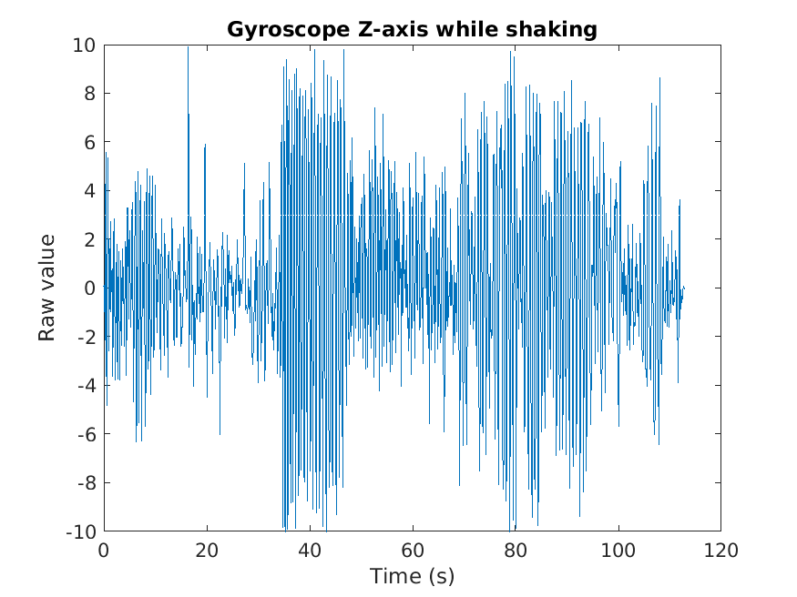
Visualized Motion Data
Data of gyroscope Z-axis

Slide 8
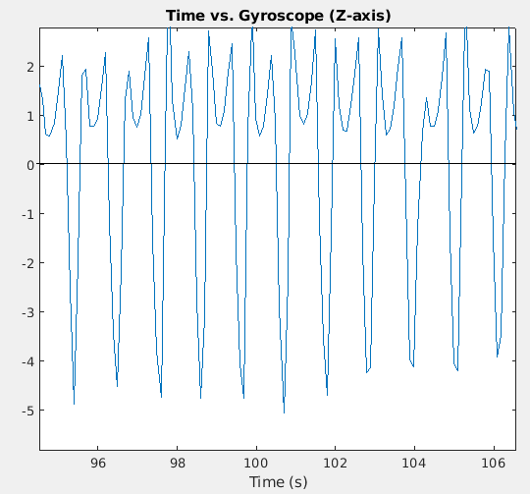
Visualized Motion Data
*Zero-crossings indicate steps

Slide 9
Bluetooth Features
Device may operate as a headless unit without client
Step counting will still occur without a client connected
Functionality is added with a client connection
Neural network is run on client if connected
Client receives data over Bluetooth and executes with faster processor
Graphical user interface to pedometer is available with a client connection
User may view motion data (current activity, step count, time elapsed)
User may reset step count and begin new session

Slide 10
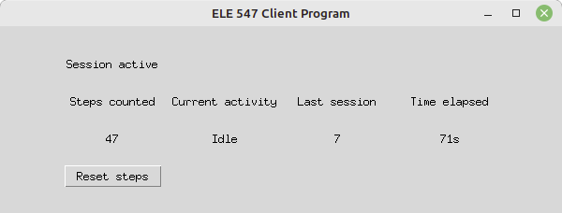
Graphical User Interface
Client program includes a GUI
User interface allows user to view:
Current session’s step count
Last session’s step count
Elapsed time of the current session (in seconds)
Current activity type (walking or idle)
User can reset step count to begin a new session
Screenshot of GUI running on a client host

Slide 11
Motion Classifier
Classifier is comprised of two 1D convolutional neural networks with outputs connected to a single output layer
97.4% accurate, based on validation data
Uses Sense Hat gyroscope X-axis and Z-axis as input data (equal weights)
Can determine if user is idle or walking through 10 data points (1s, 100ms sampling)
Classifier was trained using real-world data collected for this project
91758 data points collected by developer using custom training script running on Pi
Training data was collected to train classifier to recognize walking, idle motion, intentional tampering

Slide 12
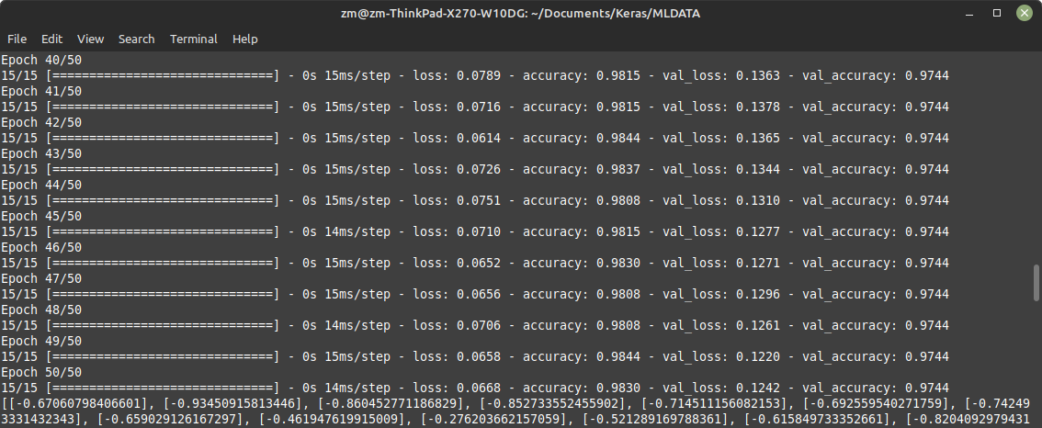
Classifier Training

Slide 13
Test and Evaluation Procedure
In order to determine the success of this project, the error of the pedometer step counting algorithm must be calculated
Error = (Measured - Expected / Expected) * 100
Accuracy = 100 - error
Test: Walk 500 steps wearing the pedometer, while keeping track of steps with a mechanical counting device.
Increment the mechanical counter every time the right foot hits the ground
Record pedometer steps using client program when mechanical counter reads 500 steps
Repeat three times.
Calculate error using an expected step count of 500 steps and the actual measured value of the pedometer

Slide 14
Test Results
Trial | Steps measured
1 | 453
2 | 465
3 | 466
4 | 467
5 | 480
Average error = (466.2-500)/500*100 = -6.7 ∓ 1.675 % (95% C.I.)
Goal of this project was to meet or exceed accuracy of iPhone pedometer
In a Stanford study (2), iPhone pedometer error was determined to be -7.2% +/- 13.8% (Ata, R., Gandhi, N., Rasmussen, H. et al.), N = 76
Assume that performance of the pedometer meets that of the iPhone, therefore project was a success
Goal was to be within +/- 10% of iPhone

Slide 15
Comparison to Commercially-Available Pedometers
Pedometer type | Position Worn | Accuracy (%)
Fitbit Charge | Wrist | 80.32 ∓ 18.63
Garmin Vivofit | Wrist | 97.20 ∓ 2.08
Fitbit Zip | Waist | 98.81 ∓ 0.61
Digiwalker | Waist | 89.81 ∓ 14.43
Omron | Waist | 99.16 ∓ 0.84
Yamax EX-510 | Waist | 98.87 ∓ 0.89
Accusplit | Waist | 99.14 ∓ 1.21
This project | Leg | 93.3 ∓ 1.675
Data collected in study published by Hergenroeder et al (3), gait speed > 1.0m/s, data is represented as M ∓ SD

Slide 16
Challenges
Slow execution time of Pi ARM processor
Solution 1: offload neural network processing to client machine
Solution 2: make use of multiple cores with multi-threading, using multi-threading library and Unix sockets for interprocess communication
Slow polling time over Sense Hat API interface
Solution: modify Sense Hat API to replace dictionaries with lists
Original concept used Wi-Fi / UDP sockets and could not be tested outside
Solution: Bluetooth RFCOMM sockets using Pybluez API

Slide 17
Conclusion
The result of this project is a smart pedometer that approximately meets the accuracy of the ubiquitous iPhone pedometer and approaches the accuracy of several commercially-available pedometer models despite only a few weeks of development.
Given its remarkable accuracy and short development time, this project was a success.

Slide 18
Demonstration
https://youtu.be/Qg-AyK9L6gE

Slide 19
References
Wise, J. M., & Hongu, N. (2014). Revised 10/14AZ1491 Pedometer, Accelerometer, And mobile technology for Promoting Physical Activity. University of Arizona College of Agriculture and Life Sciences.
Ata, R., Gandhi, N., Rasmussen, H. et al. Clinical validation of smartphone-based activity tracking in peripheral artery disease patients. npj Digit. Med. 1, 66 (2018). https://doi.org/10.1038/s41746-018-0073-x
Hergenroeder AL, Barone Gibbs B, Kotlarczyk MP, Perera S, Kowalsky RJ, Brach JS. Accuracy and Acceptability of Commercial-Grade Physical Activity Monitors in Older Adults. J Aging Phys Act. 2019 Apr 1;27(2):222-229. doi: 10.1123/japa.2018-0036. Epub 2018 Nov 21. PMID: 30117355; PMCID: PMC7023914.

